Slide 1
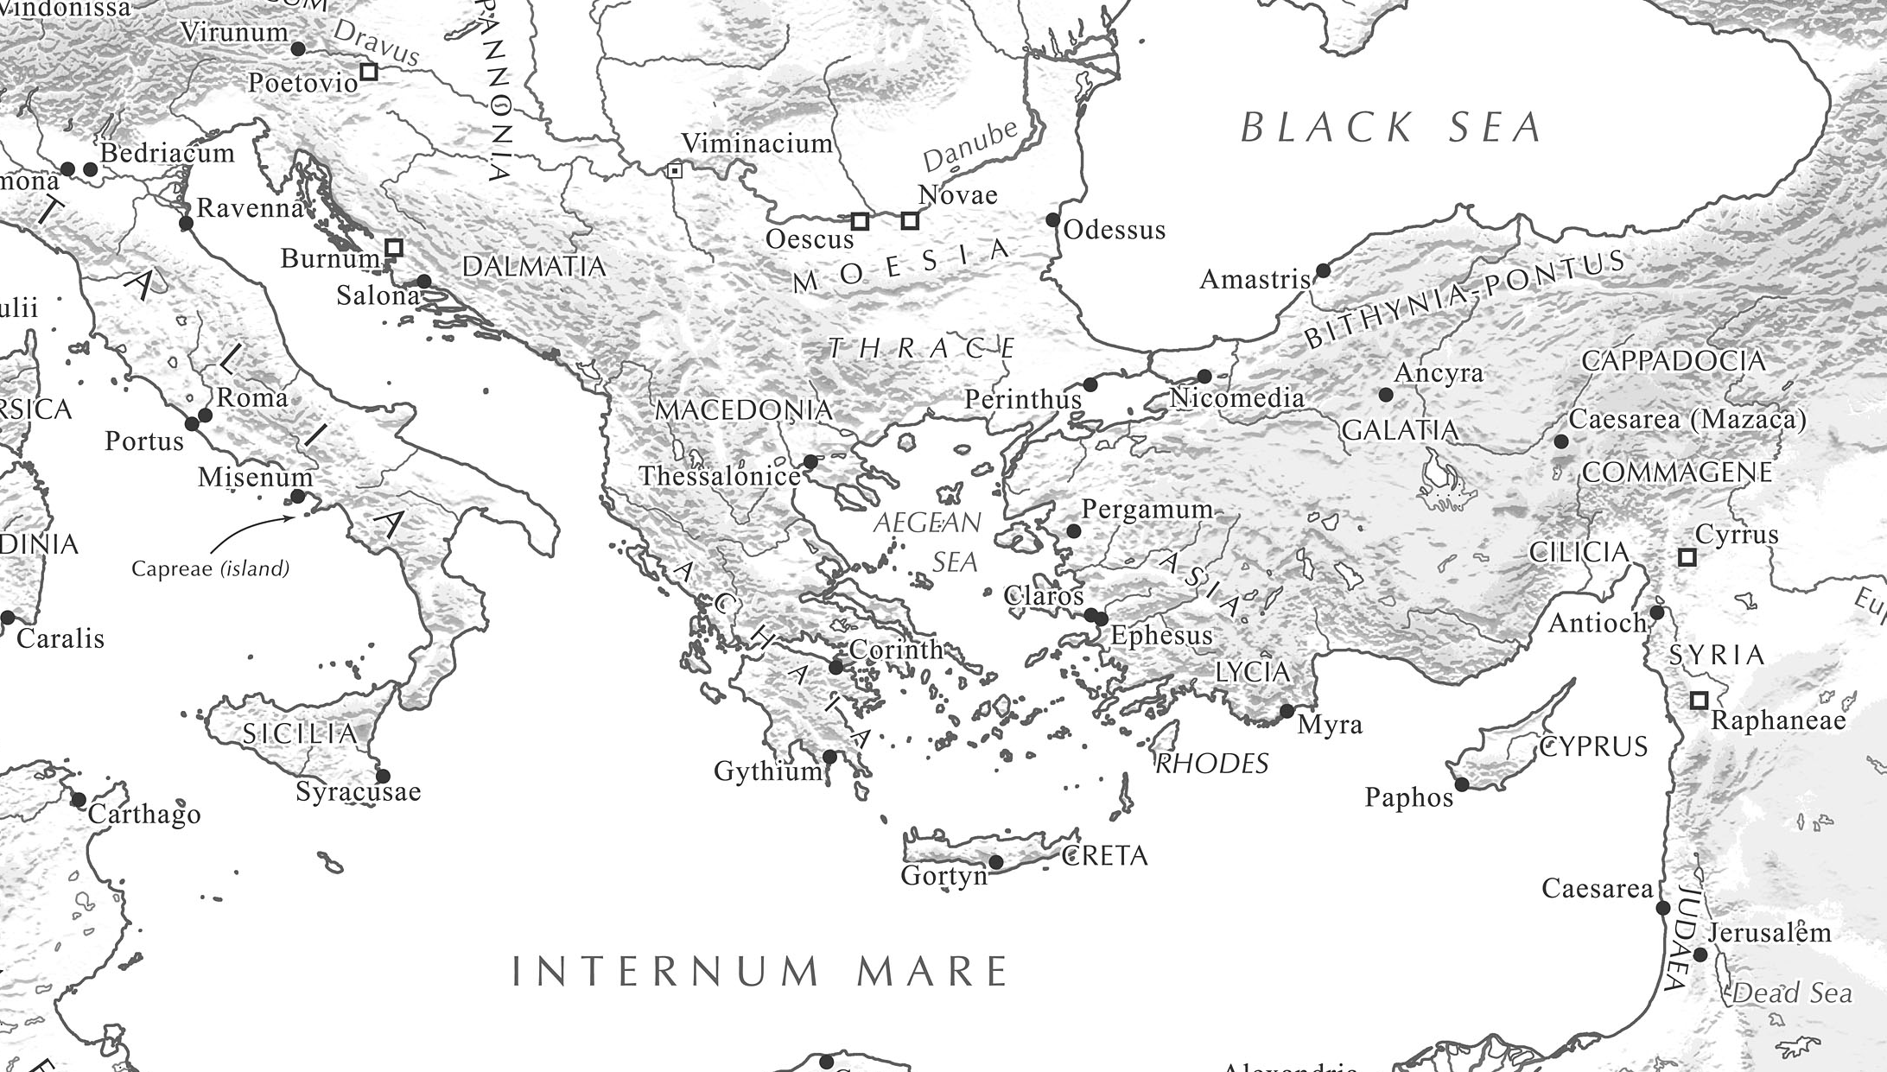
Paul’s Missionary Journeys
Roman Empire ca. 50 A.D.

Slide 2
Journey #1 (12 months) Acts 13-14
CYPRUS – whole island receives gospel in 2 months via gospel & signs
PHRYGIA – less than 1 month
Paul targets capital city – PISIDIAN ANTIOCH
Movement results through whole region
Joy-filled discipled
Paul run out by persecution
GALATIA – 3-4 months
ICONIUM – large number believe via bold witness & signs; run out by persecution.
LYSTRA – non-Jewish background believers via sign and witness. Run out by persecution.
DERBE – Many disciples
Returned & strengthened believers (7 months?)
Solidified churches (appoint elders)
Phrygia
Galatia
Cyprus

Slide 3
Journey #2 (3-4 years) Acts 15:36-18:22
CYPRUS – Barnabas & Mark visit believers
GALATIA & PHRYGIA – revisit believers (2-4 mos)
ASIA, MYSIA, BITHYNIA prevented by Holy Spirit
MACEDONIA – 3-4 months
PHILIPPI – witness via 2 POPs, miracle. Sent away by authorities
THESSALONICA – large number of disciples. Run out by Jews
BEREA – large number of disciples. Run out by Jews but Paul & Silas stay longer
ACHAIA – 1.5 years
ATHENS – few disciples, poor response
CORINTH – great harvest; Priscilla & Aquila. Protected by authorities; stay 1.5 years. Weekly training. Reach most of Achaia
Touches Ephesus briefly; leaves P&A
Macedonia
Paul & Silas
Phrygia
Galatia
Achaia
Barnabas & Mark
Cyprus

Slide 4
Journey #3 – (4-6 years) Acts 18:23-20:38
GALATIA & PHRYGIA – revisit believers – several weeks - months
ASIA – 3 years
EPHESUS – daily witness & training by Paul; great signs; radical commitment & life transformation
ALL ASIA hears gospel
Ephesus as a BASE
MACEDONIA/ ACHAIA revisit believers – 4-5 mos
ILLYRICUM reached
EPHESUS (Miletus) - visit believers – 1 week
NO PLACE LEFT
Illyricum reached
Macedonia
ASIA
Phrygia
Galatia
Achaia
Cyprus
Romans 15 –
From Jerusalem to Illyicum . . . no place left for me in these regions.

Slide 5
Paul’s Timeline
Galatians 1-2 / Acts
Jesus’ Ascension 30-35 AD
Paul’s Conversion 35 AD (Acts 9)
Nero’s Persecution
3 Years in Arabia Galatians 1:18
Acts Concludes
Roman Prison - 2 years (Acts 28:30)
Intro. to Jerusalem (Acts 9:27)
Caesarean Prison - 2 years (Acts24:27)
Tarsus/Antioch (Acts 9:30-13:1)
Jerusalem Council (Acts 15)
Famine Relief (Acts 11) 45 AD - Josephus
A.D. 33 35 40 45 50 55 60 64
1st Missionary Journey (Acts 13-14)
2nd Missionary Journey (Acts 15:36-18:22)
3rd Missionary Journey (Acts 18:23-20:38)
CONCLUSION: Paul’s Journeys Covered Less Than 15 Years!
Note: Date of Jerusalem Council based on Galatians 2:1 (14 years after introduction of Acts 9)

Slide 7
Lessons from Paul’s situation?
6 basic CPM streams
Once there were sustained CPMs he felt finished
He tackled regional centers
Helped the locals expand to the area
Moved on when this was working well (when possible)
He had 2 priorities
Work night and day to win devoted followers
Thru witness, signs, life transformation
Help them begin multiplying in their witness.
He planted the DNA of multiplying disciples
ACCESS CRITICAL: He worked with his disciples in a weekly or daily process
He stayed as long as possible
Imparted his LIFE to them
CP appears to have been by witnessing Christians along the way
He had key trainers / helpers in each region
He returned whenever he could to help the movement continue
Not much else!

Slide 8
Paul’s Disciples
Core Team: Barnabas, Silas, Timothy, Pricilla/Aquila, Titus and Luke
Emerging Leaders: Jason, Dionysius, Justus, Lydia, Erasmus, Stephanus, Gaius, Phoebe, Crispus, Sosthenese, Apollus, Epasphrus, Aristarthus, Fortunatus, Archaicus, Andronicus, Julius, Erastus, Tertius, Linus, Eubulus, Cladia, Mark, Artemas, Tychichus, Clement, Onesimus, Demus, Epaphroditus, Zenus, Crescent, Carpus, Onesiphorus, Claudia, Prudens….

